Slide 1



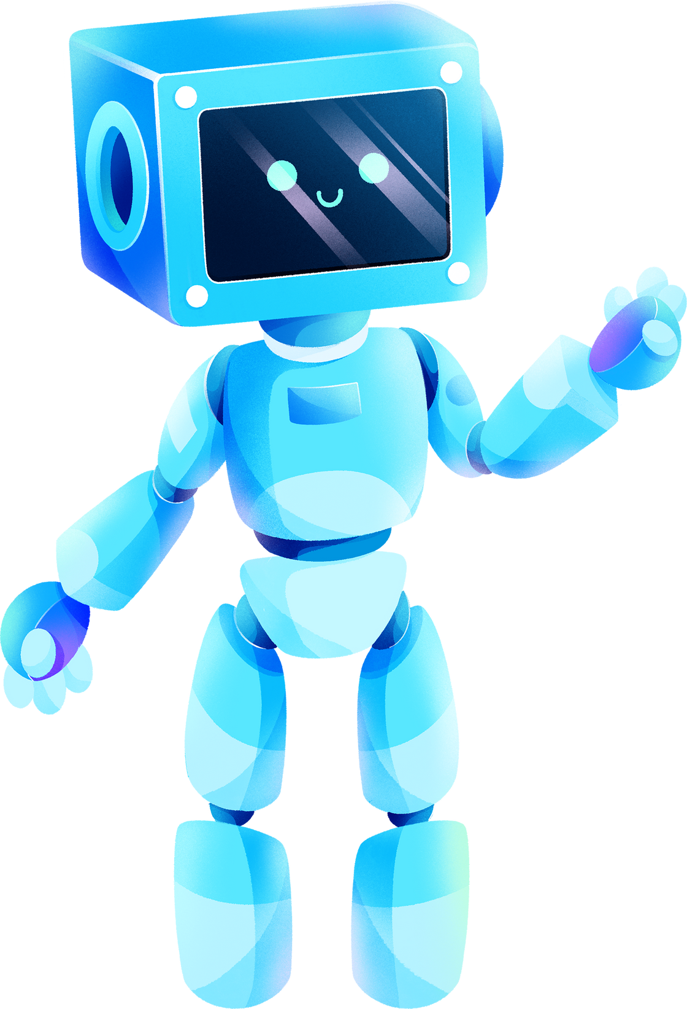
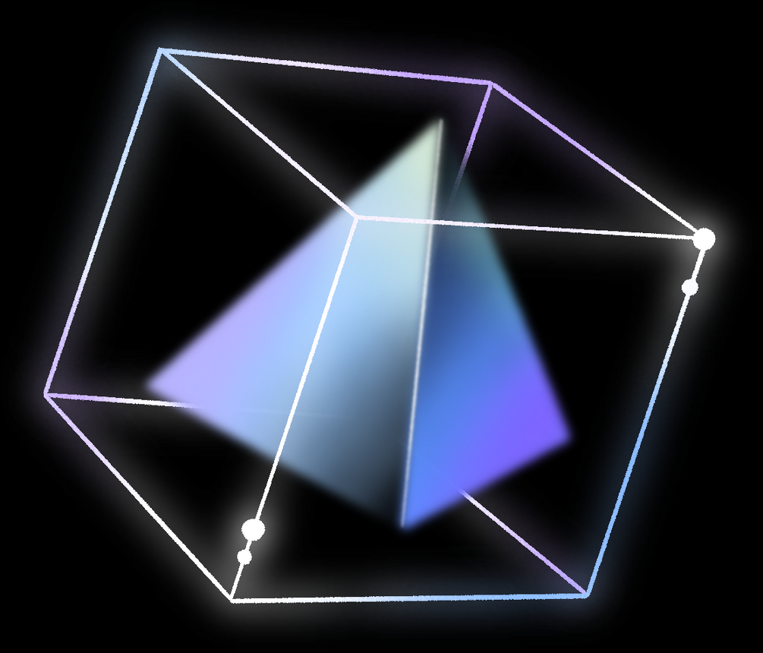
STEMROBO TECHNOLOGIES
UCMAS
By kipngeno Koech

Slide 2

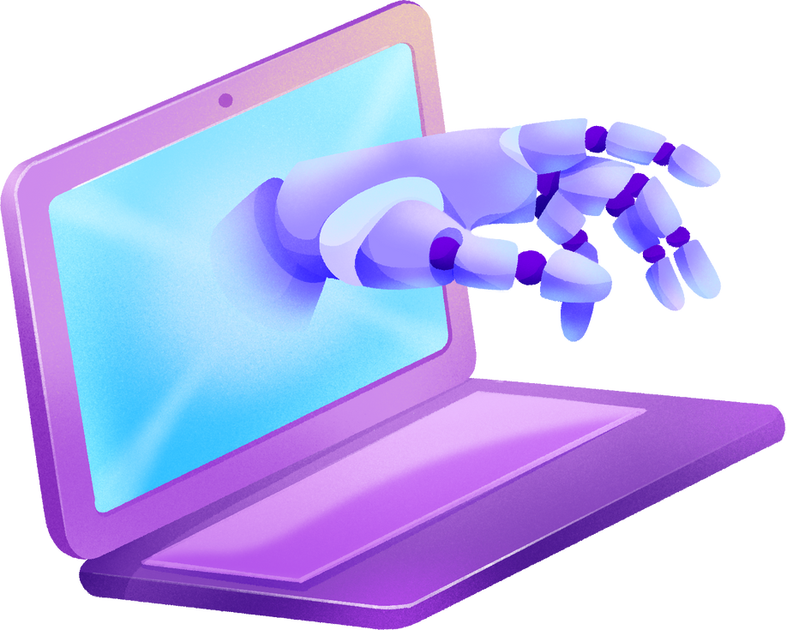
ROBOTS MEETS HUMANS
Friendly Robots as Helpers
Imagine having a robot friend that can help you tidy up toys or even play games with you!
Teaching Robots to dance and do fun stuff!
Imagine being a mini magician, instructing your robot to dance, draw, or do special tricks. It's like having your own creative sidekick ready to bring your ideas to life!

Slide 3

WHAT WE DO
we leverage technology in Education where STEAM, Robotics, Coding & AI are utilized by kids to become smart in Academics and be able to solve modern world problems
MISSION
To Equip Students with 21st century skills coding robotics and AI

Slide 4

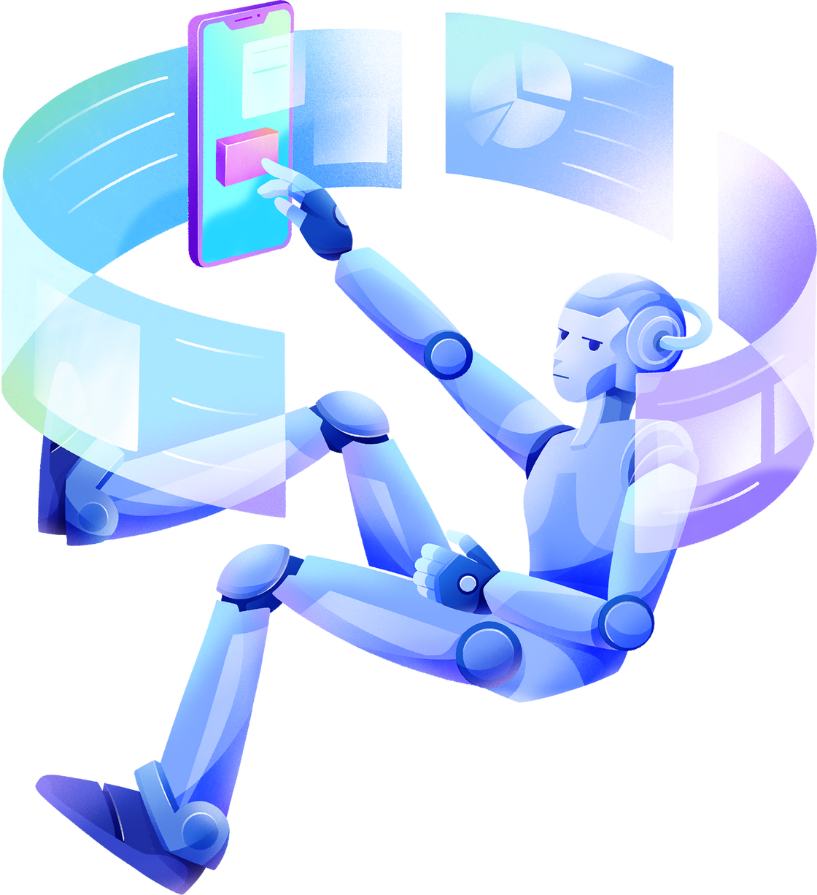

OUR
STACK

Slide 5


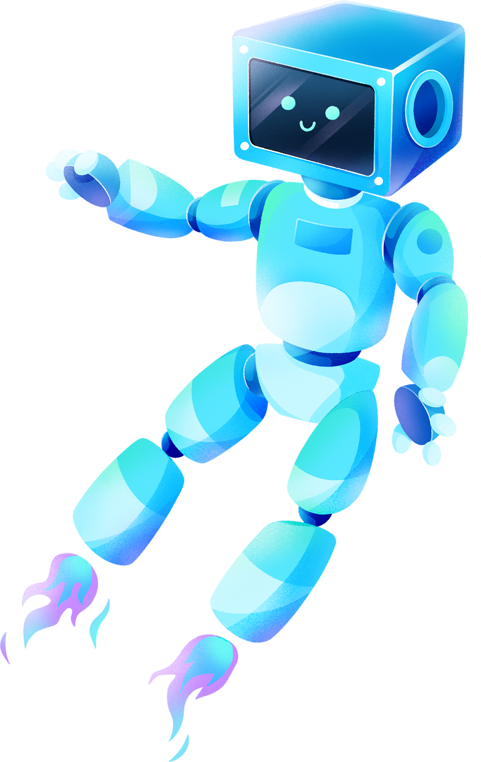



21ST CENTURY SKILLS DEVELOPMENT
21st-century skills equip us to think critically, create innovatively, and collaborate seamlessly, fostering adaptability and global awareness in a world driven by technology and constant change.
IN-HOUSE PRODUCT DEVELOPMENT
In-house product development involves creating and refining products within a company's own team, allowing for greater control, customization, and alignment with specific business needs, fostering innovation and quality control.
DIY PROJECTS
DIY projects are like super fun adventures where you get to make cool things with your own hands! It's like being a little inventor, creating toys, decorations, or anything you imagine, making everything special and uniquely yours.
REAL-WORLD PROBLEM SOLVING
Real-world problem-solving is like being a superhero who figures out how to fix things in everyday life. It's about finding smart solutions to challenges, making the world a better place, and being a problem-solving hero!

Slide 6
21ST CENTURY SKILLS
Reasoning
Self-confidence
application
Judgment
Creativity
Photographic memory
Observation
01
02
03
04
05
06
07

Slide 7

THINGS WE ARE GOING TO LEARN
01
02
03
04
Scratch programming
"Welcome to Scratch, where coding transforms into a vibrant adventure. This platform is your canvas for code, inviting you to unleash creativity through visual programming. Build, create, and bring your ideas to life with a simple drag and drop, crafting interactive stories, games, and animations effortlessly
Robotics
Think of robots as your friends who can do cool things. We use special instructions to tell them what to do. It's like magic! We make robots move, talk, and even play with us.
Artificial Intelligence
AI, or Artificial Intelligence, is like giving computers a super-smart brain. It helps them learn, think, and do things on their own. Just like how you learn new things, AI helps computers learn and make decisions all by themselves!
coding
Think of coding like giving your computer a recipe to bake cookies. You tell it what ingredients to use and the steps to follow. In coding, you're telling the computer how to play a game, like making a cat jump or drawing a picture!

Slide 8






SCRATCH 101
BUILT-IN MEDIA LIBRARY:
VISUAL CODING BLOCKS:
INTERACTIVE PROJECTS:
What Stands Out: Access to a diverse library of sounds, images, and sprites within Scratch.
Why it's Noteworthy: The built-in media library expands creative possibilities by offering a wide range of elements that users can incorporate into their projects, enhancing the overall richness of their creations.
What Stands Out: The use of colorful, draggable code blocks that snap together like puzzle pieces.
Why it's Noteworthy: It makes coding accessible and fun, especially for beginners who can visually understand how different code elements fit together.
What Stands Out: The ability to create interactive stories, games, and animations.
Why it's Noteworthy: Scratch allows users to go beyond static projects, encouraging creativity by enabling the creation of dynamic and engaging digital experiences.

Slide 9




HOUSE RULES
Have fun
01
refer to rule number 1
02

Slide 10
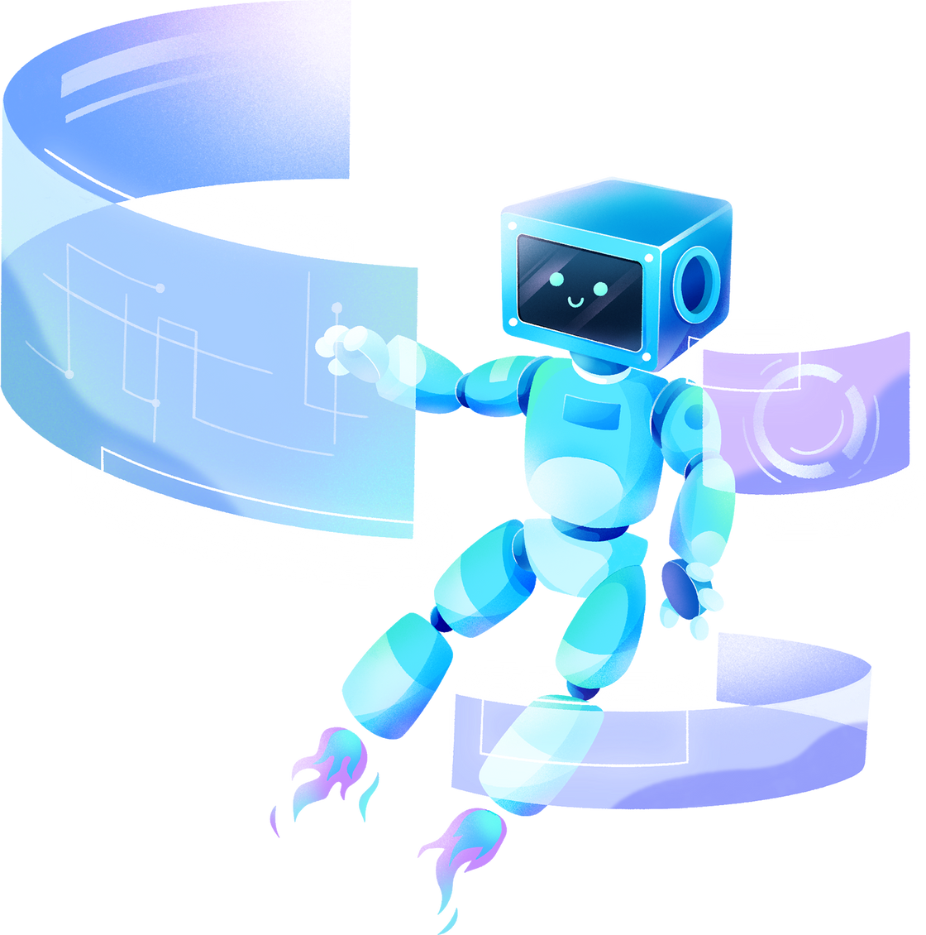
THANK YOU!

